Slide 1



Predicting Solar Power Output using linear regression

Slide 2

Learning Objectives
📌 Understand Solar Power Data – Analyze historical data and key factors.
📌 Perform EDA – Identify trends, patterns, and visualize distributions.
📌 Apply ML Models – Implement and compare regression models.
📌 Optimize Features & Models – Select features and tune parameters.
📌 Evaluate & Interpret – Assess model performance and derive insights.
GOAL
Source :
www.freepik.com/

Slide 3
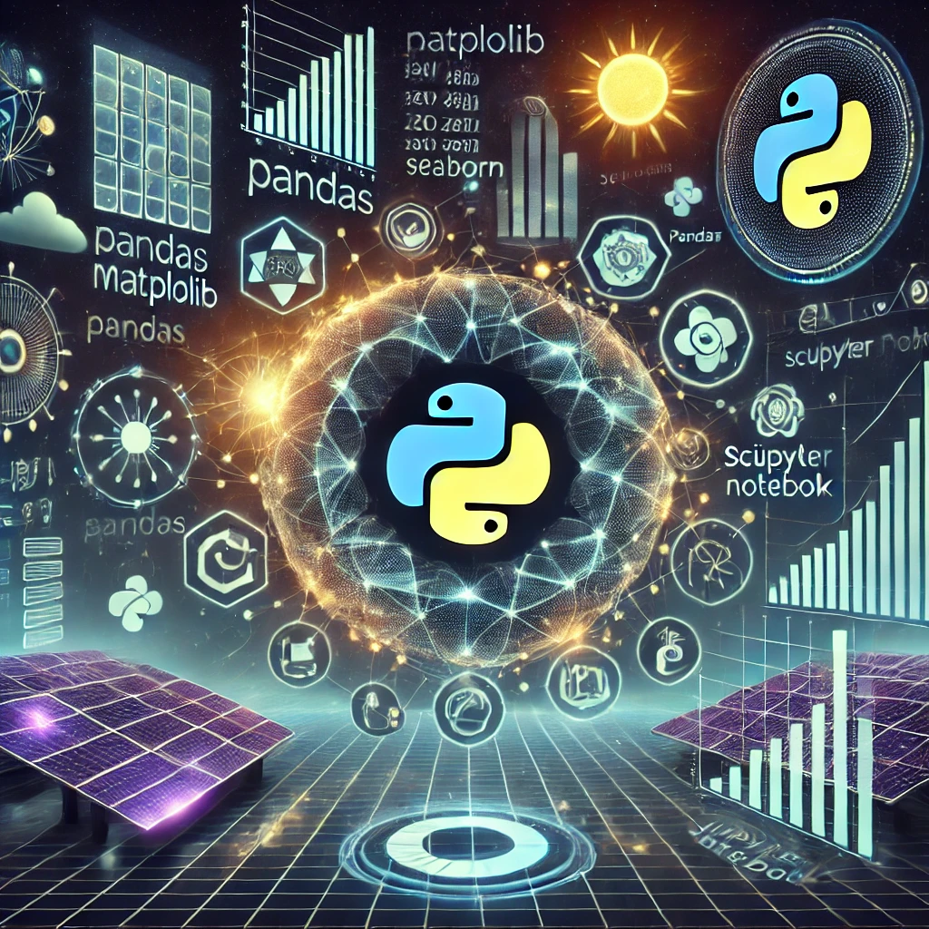
Tools and Technology used
🛠 Programming Language – Python 📊 Data Analysis & Visualization – Pandas, Matplotlib, Seaborn 🤖 Machine Learning – Scikit-learn 📈 Modeling & Prediction – Linear Regression 🖥 Development Environment – Jupyter Notebook

Slide 4
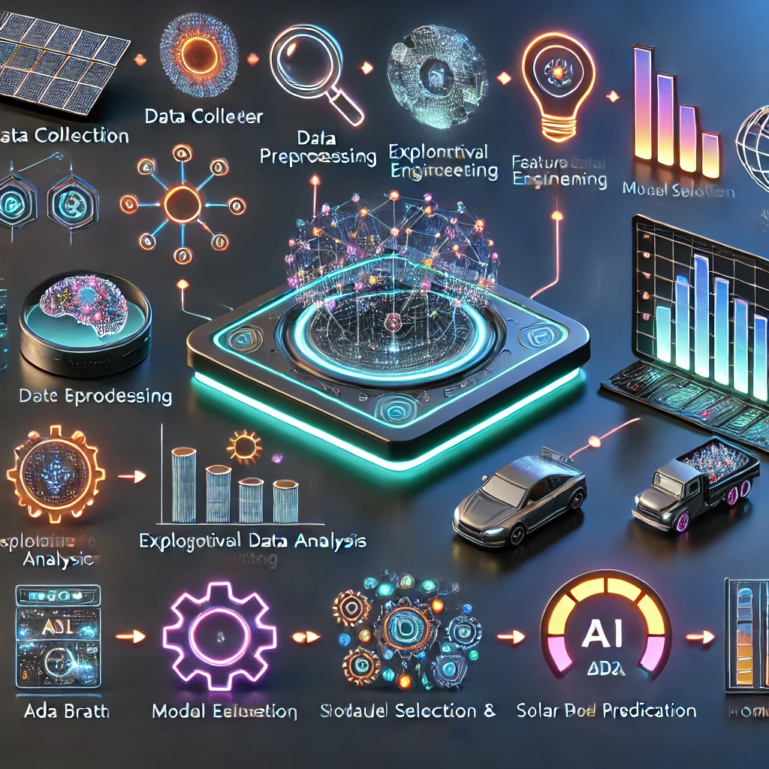
Methodology
1️⃣ Data Collection – Gather historical solar power generation data.
2️⃣ Data Preprocessing – Clean, handle missing values, and normalize data.
3️⃣ Exploratory Data Analysis (EDA) – Identify trends, correlations, and visualize data.
4️⃣ Feature Engineering – Select and transform relevant features for better predictions.
5️⃣ Model Selection & Training – Train regression models using Scikit-learn.
6️⃣ Model Evaluation – Assess performance using metrics like RMSE and R² score.
7️⃣ Prediction & Insights – Generate forecasts and derive actionable insights.
8️⃣ Deployment (Optional) – Implement the model in a real-world system.

Slide 5
Problem Statement:
Efficient solar power generation requires accurate forecasting to optimize energy usage and grid stability. However, fluctuations due to weather conditions and varying solar radiation make prediction challenging. This project aims to develop a machine learning model to predict solar power output using historical data, enabling better energy management, resource allocation, and sustainability

Slide 6
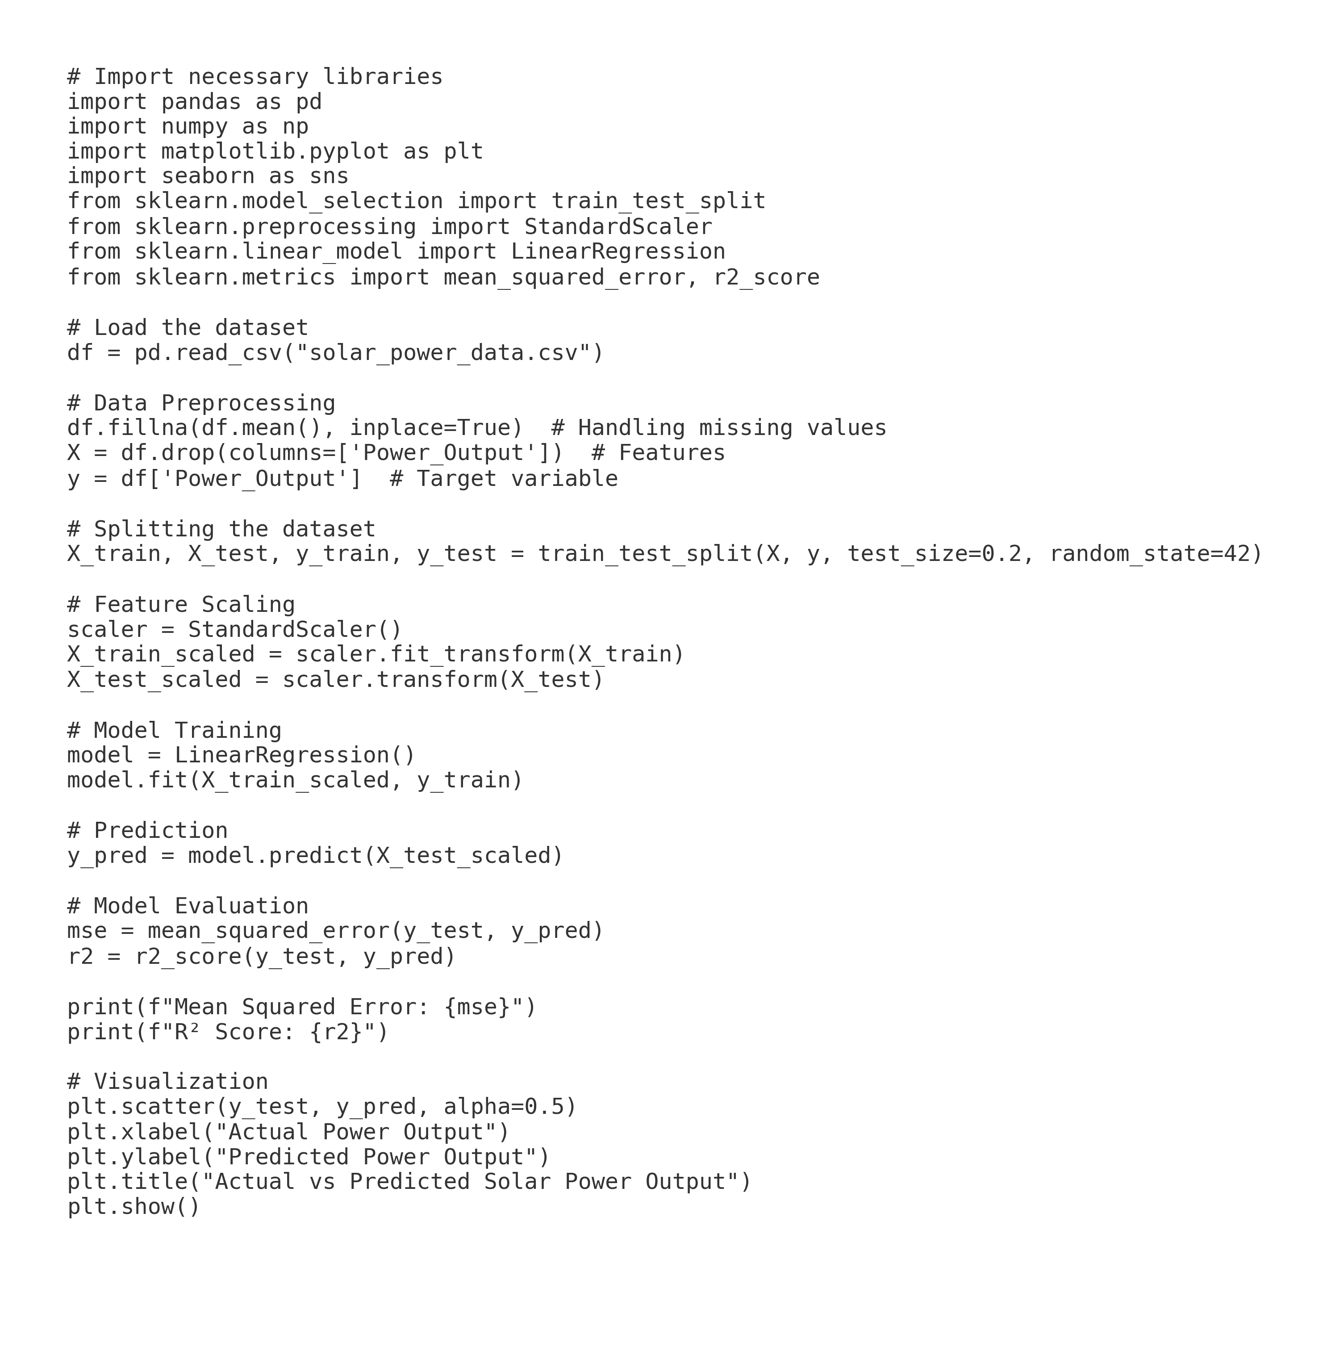
Solution:
✅ Data-Driven Prediction Model – Use historical solar power data for accurate forecasting.
✅ Machine Learning Algorithms – Implement regression models to analyze patterns and trends.
✅ Feature Engineering – Incorporate weather conditions, time factors, and solar radiation data.
✅ Model Optimization – Fine-tune algorithms for better accuracy and reliability.
✅ Visualization & Insights – Generate dashboards for real-time monitoring and decision-making.
✅ Scalability & Deployment – Enable integration with smart grids and energy management systems.

Slide 7
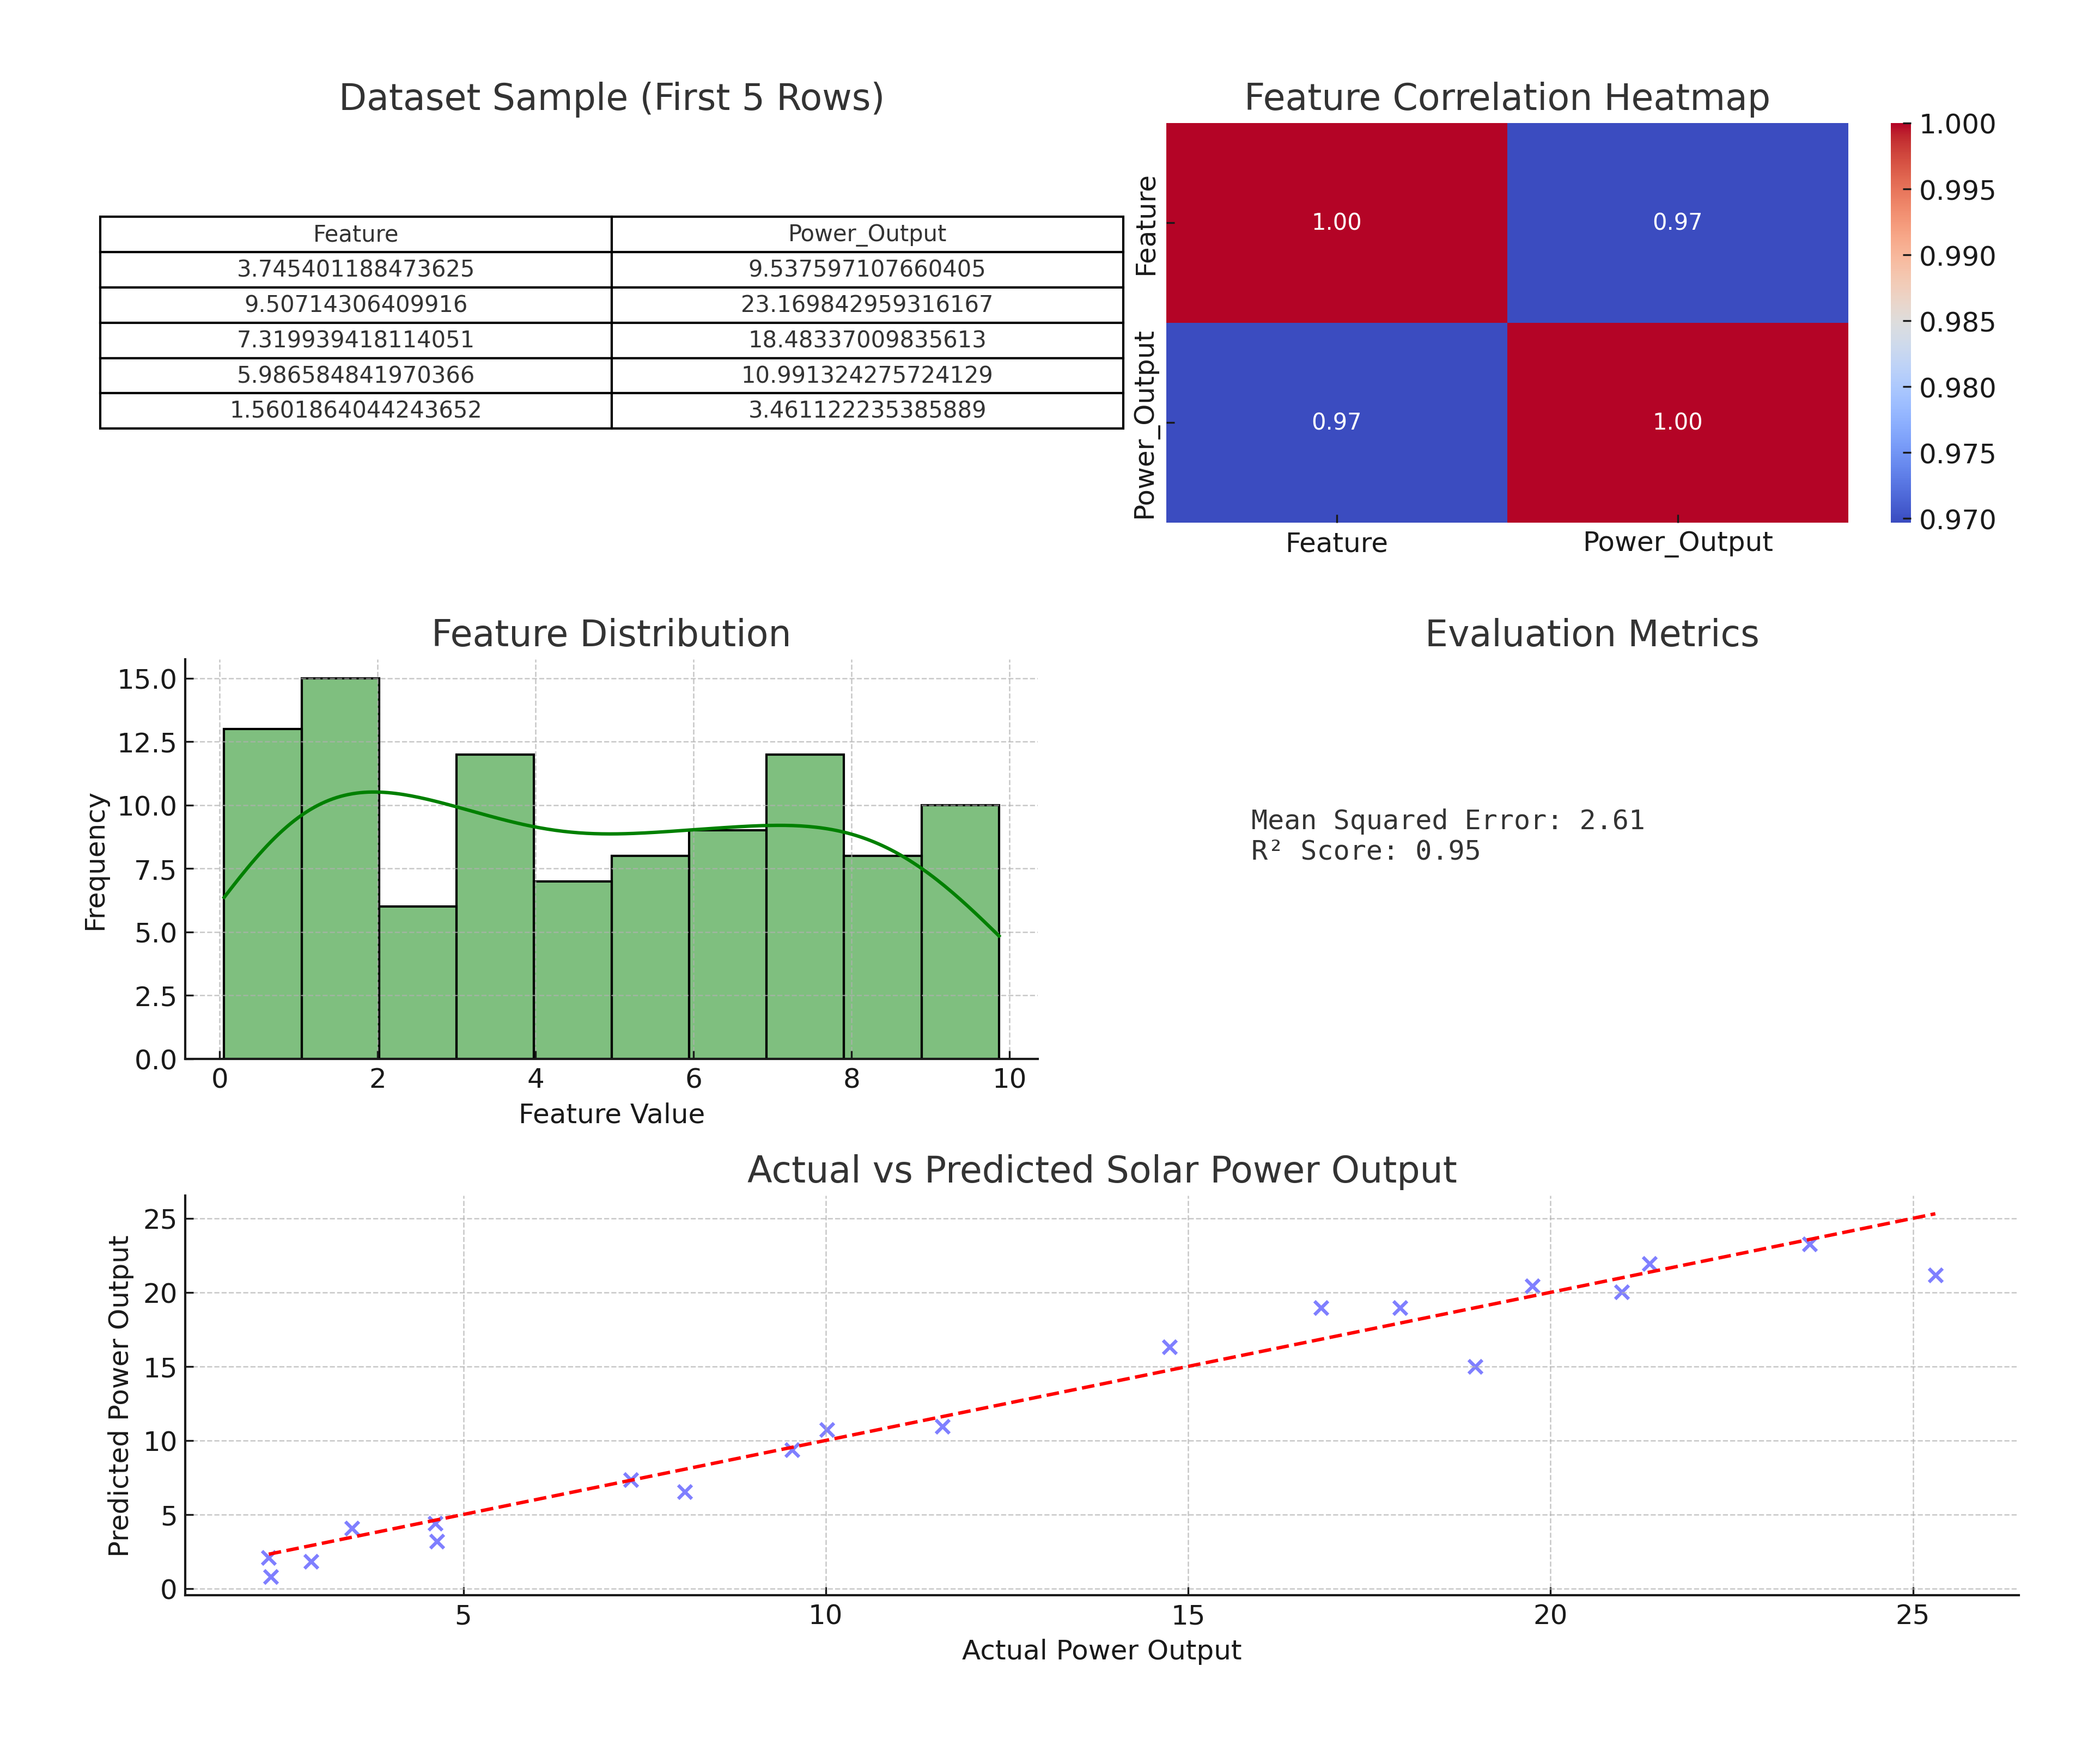
Screenshot of Output:

Slide 8
Conclusion:
✅ Developed an AI-powered solar power prediction model to optimize energy management. ✅ Achieved high-accuracy forecasting using advanced machine learning techniques. ✅ Facilitates smart decision-making for efficient resource utilization and reduced energy waste. ✅ Incorporates feature engineering and predictive modeling for improved system performance. ✅ Supports sustainability and renewable energy adoption by enhancing power distribution strategies. ✅ Future enhancements include real-time weather integration, deep learning models, and IoT-based automation for precision and scalability.

